Slide 1



Stats Analysis

Slide 2
Topics to be covered
Introduction to Inferential Statistics
Probability
Conditional Probability
Normal Distribution
Standard Deviation
Standard Normal Distribution
Standard scores (Z- score)
Central Limit Theorem
Hypothesis Testing
P-value
Confidence Intervals

Slide 3
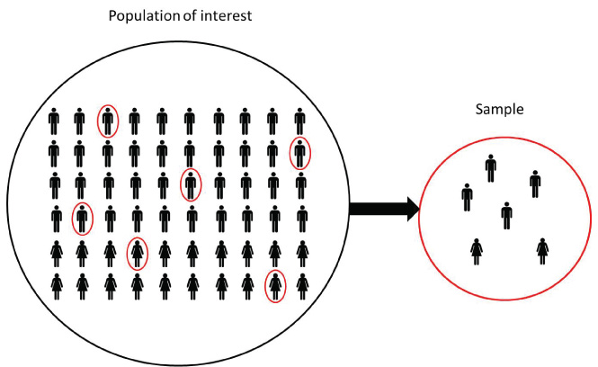
What is Inferential Statistics?
Inferential statistics allows you to make predictions (“inferences”) from that data. With inferential statistics, you take data from samples and make generalizations about a population.
POPULATION
SAMPLE

Slide 4
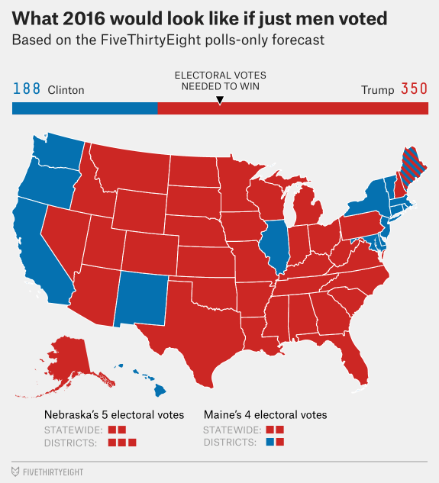



Real world usage
Elections Poll
Survey Samples

Slide 5
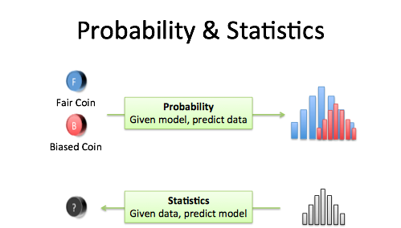


Building block of Inferential Stats: Probability
Let us speak about Probability in the next few slides

Slide 6

What is probability?
Probability is the chance that something will happen.
It is a measure how likely is that event to occur.
It is the likelihood of occurrence of an event
An event that occurs for sure is called a Certain event and its probability is 1
An event that doesn’t occur at all is called an impossible event and its probability is 0
Ranges between 0-1

Slide 7


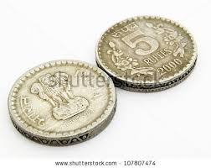

We draw on previous experience to determine how something is likely to occur?
Getting 6 on rolling a dice?
Getting Tatkal Train Ticket
AI sector certain to be future.
Head or Tail?

Slide 8
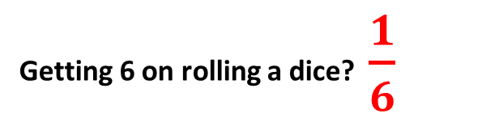
We draw on previous experience to determine how something is likely to occur?
Getting 6 on rolling a dice? $\frac{1}{6}$
Getting Tatkal Train Ticket
5%
AI sector certain to be future. 90%
Head or Tail?
0.5

Slide 9
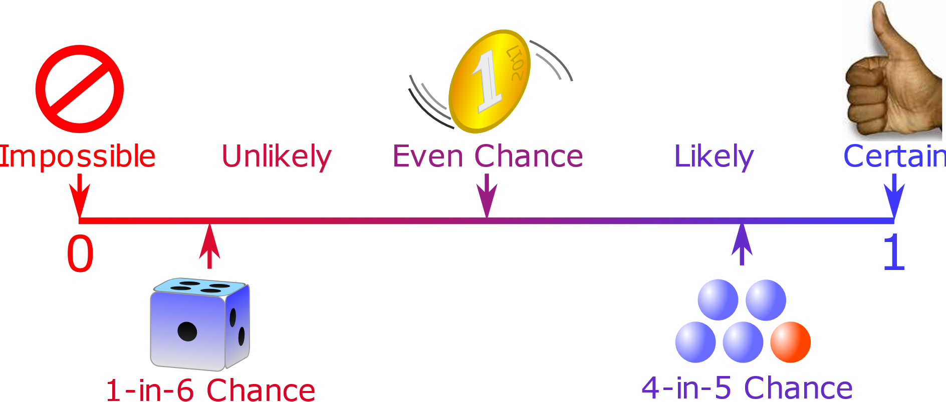
Probability of an Event

Slide 10
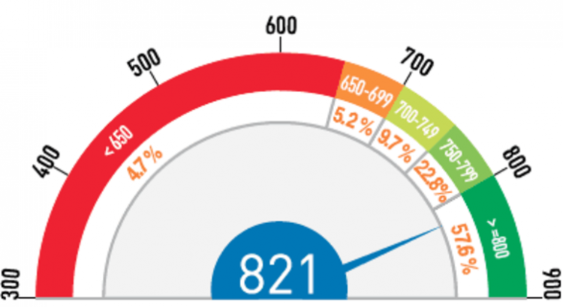
Why is Probability essential?
Probability is the foundation and basic language needed for most of the statistics to get certainty to into decisions.
Customers having
CIBIL score >= 800,
are more likely to be eligible for loan, as they have nearly
57.6% chance of repaying back the loaned amount.

Slide 11

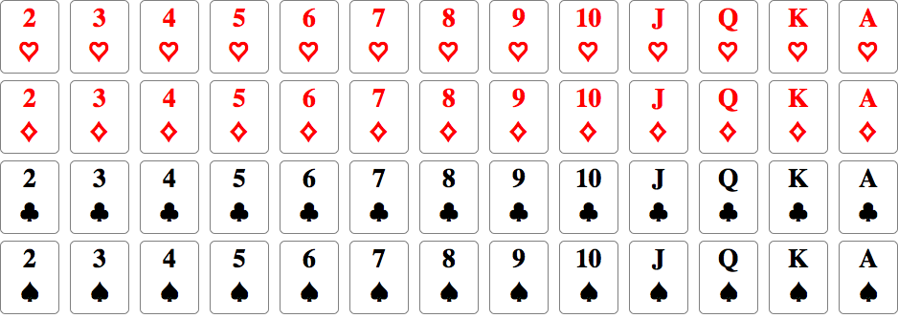
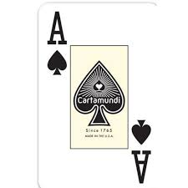
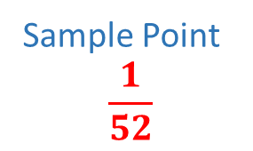
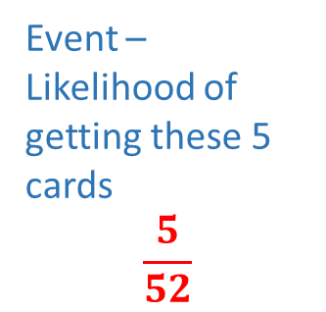
Components of conducting an experiment.
Event – Likelihood of getting these 5 cards
$$\frac{5}{52}$$
SAMPLE SIZE
52
Sample Point
$$\frac{1}{52}$$

Slide 12
PROBABILITY CALCULATIONS
The probability of an event A is equal to the sum of the probabilities of the simple events contained in A.
If the simple events in an experiment are equally likely, you can calculate probability as:

Slide 13
Let us see some common type of Probability events

Slide 14
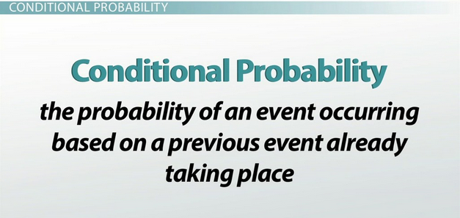
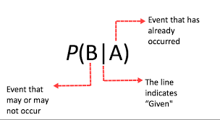
Conditional Probability

Slide 15
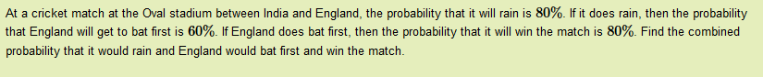
Example of Conditional Probability

Slide 16
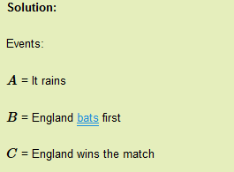
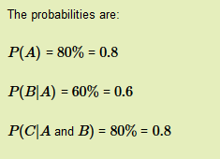

Slide 17
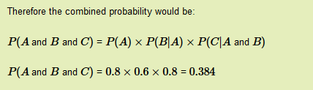


Slide 18
variable
A variable is any characteristic, number, or quantity that can be measured or counted
Variable
Numerical
Age, number of pets
Discrete
Shoe size
Continuous
Weight
Ordinal
Rating
Categorical
Gender, blood group
Nominal
Eye Color

Slide 19
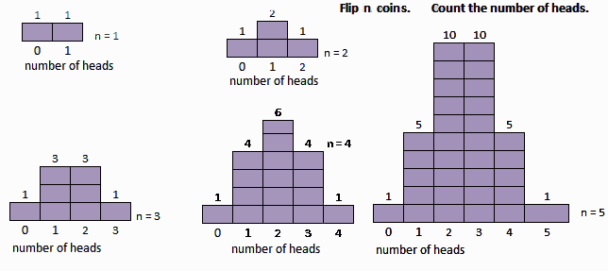
Distribution:
A distribution is simply a collection of data, or scores, on a variable.
TTT
HHH
TTH
THT
THH
HHT
HTH
TTH

Slide 20
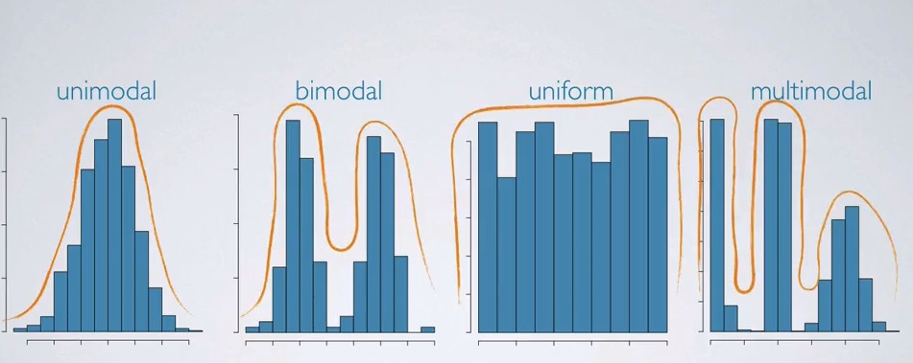
Types of Distribution

Slide 21
Normal Distribution
The Normal Distribution is a probability distribution that is symmetric about the mean , showing that data near the mean are more frequent to occur than data far from the mean.

Slide 22
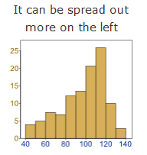
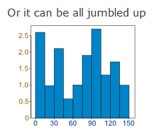
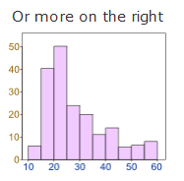
How data is distributed?
Data can be “distributed” (spread out) in different ways.

Slide 23
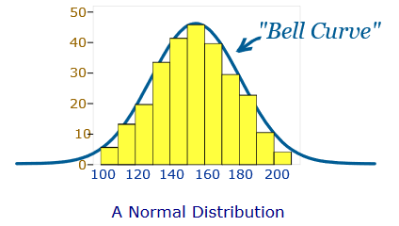
Bell Curve
But there are many cases where data tends to be around a central value with no bias left or right, and it gets close to a “Normal Distribution”

Slide 24
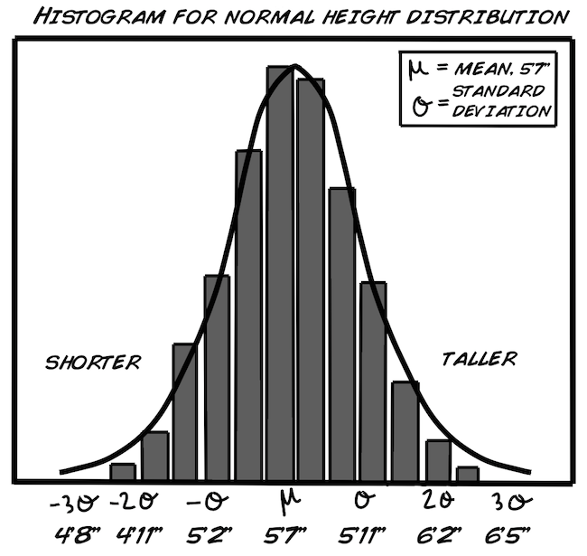
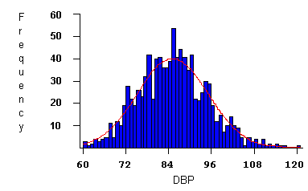
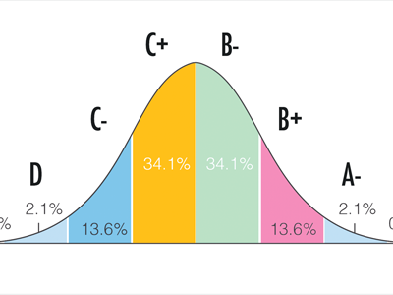
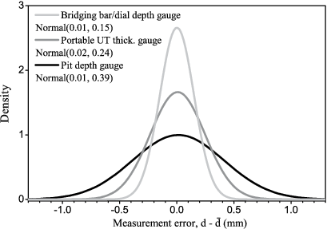
Things in real life closely following normal distribution
Height
Blood Pressure
Test Grade
Error in measurement

Slide 25
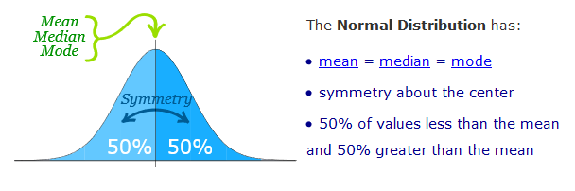
Properties of normal distribution

Slide 26
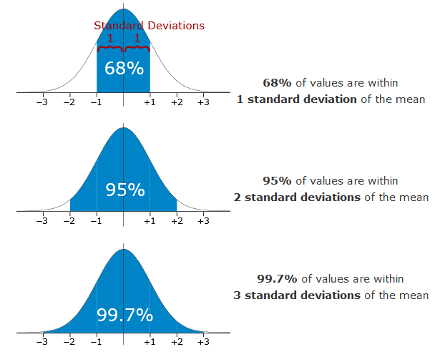
Standard Deviations
The Standard deviation is a measure of how spread out numbers are.

Slide 27
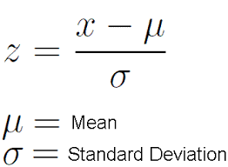
Standard Normal Distribution
Standard normal distribution is a special case of normal distribution which has a mean of 0 and a standard deviation of 1.
Any normal distribution can be converted to standard normal distribution using :

Slide 28
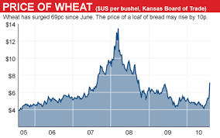
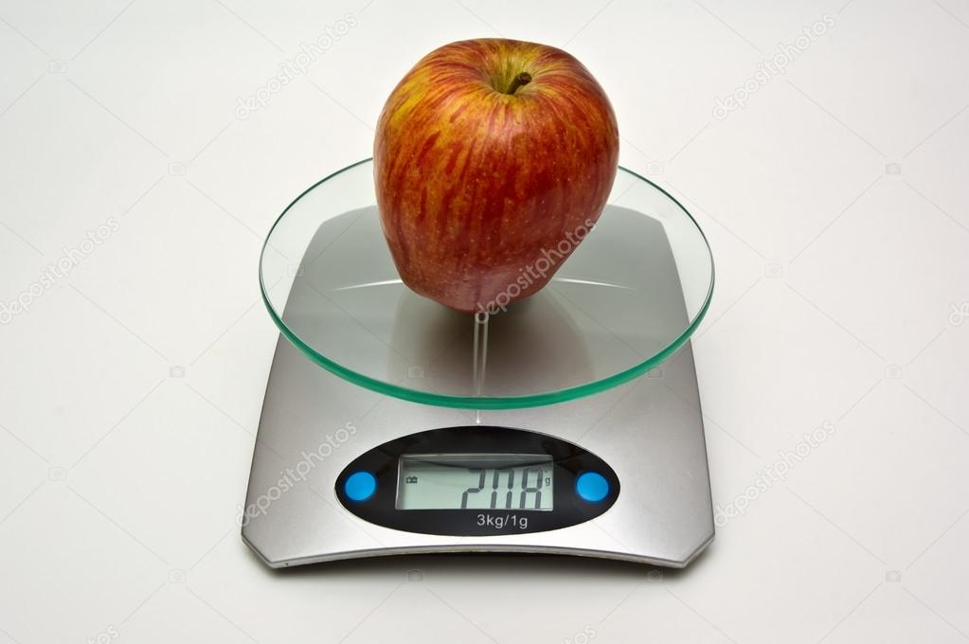
Why standardization?
Suppose we want to use price of wheat and weight of apple in same analysis. We will have to bring them down to same scale in order to conduct the analysis.
Standardization comes into picture because it converts the data into unitless data.

Slide 29
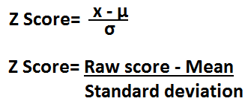
Standard Scores
A Standard score (also called Z-score) is the number of standard deviations that a raw score is above or below the mean.
Standardizing variables helps to get variables to the same scale , or makes them unit free.

Slide 30
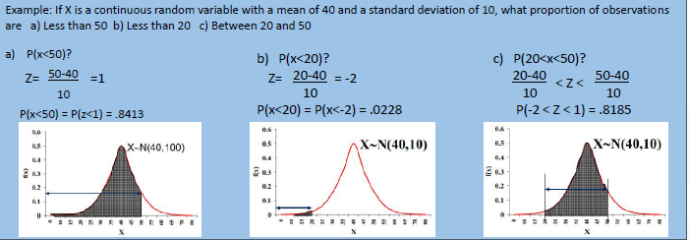
Example:

Slide 31
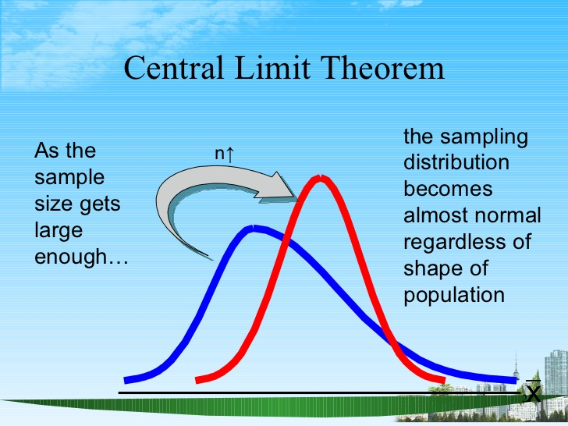
Central Limit Theorem
The sampling distribution of a sample means will become normal as the sample size increases.

Slide 32
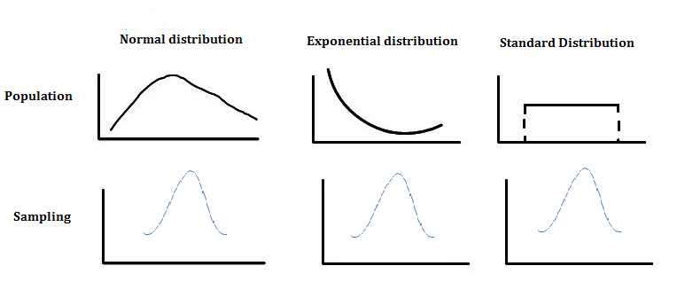
Central Limit Theorem
Central Limit Theorem
Understanding Sampling Distribution:- http://onlinestatbook.com/stat_sim/sampling_dist/

Slide 33

What is Hypothesis?
A hypothesis is an educated guess about something in the world around you. It should be testable, either by experiment or observation.
Examples:
A new medicine you think might work.
A way of teaching you think might be better.
A possible location of new species.
It can be anything at all as long as you can put it into test.

Slide 34
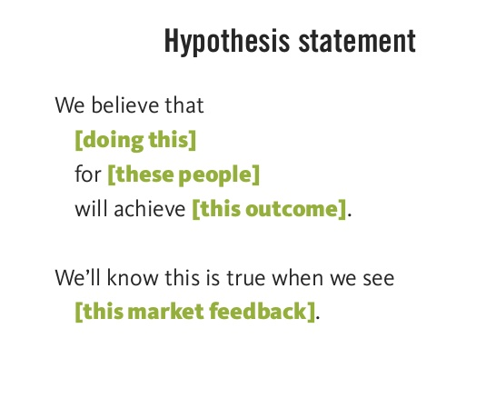
What is Hypothesis Statement?
If you are going to propose a hypothesis, it is customary to write a statement. Your statement will look like:
“If I ..(do this to an independent variable)…then(this will happen to dependent variable)”.

Slide 35
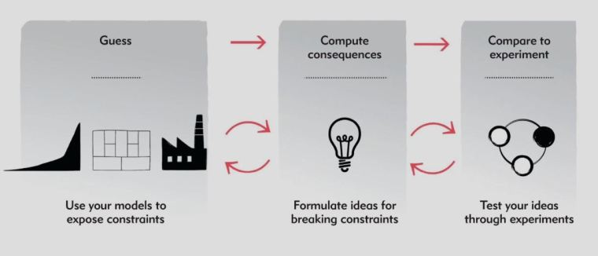
What is Hypothesis Testing?
Hypothesis testing refers to formal procedures used by statisticians to accept or reject the null hypothesis.

Slide 36
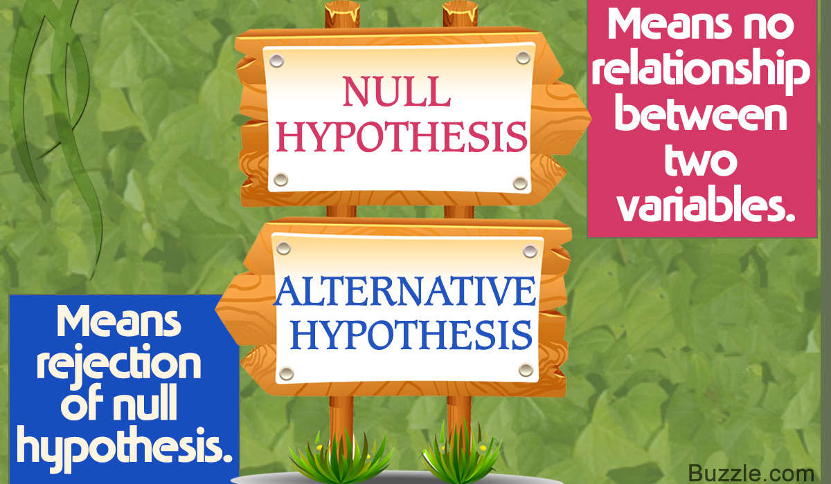
Types of Statistical Hypothesis
There are two types of statistical hypothesis
Null hypothesis: denoted by H₀, is usually the hypothesis that sample observations results purely from chance.
Alternate hypothesis: denoted by H₁ or H_{a}, is the hypothesis that sample observations are influenced by some non-random cause.

Slide 37
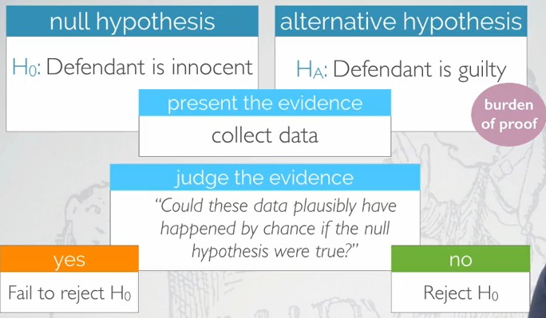
Real life example of Hypothesis testing

Slide 38
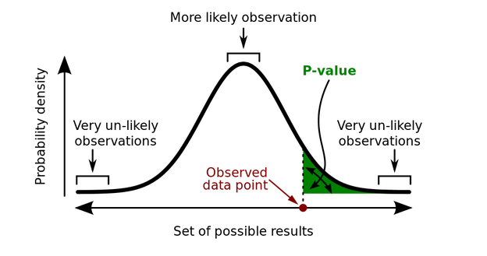
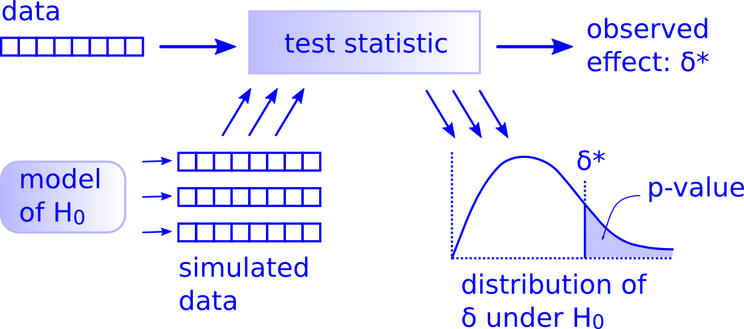
P-value
The p-value or calculated probability is the estimated probability of rejecting the null hypothesis H₀ of a study question when that hypothesis is true.

Slide 39
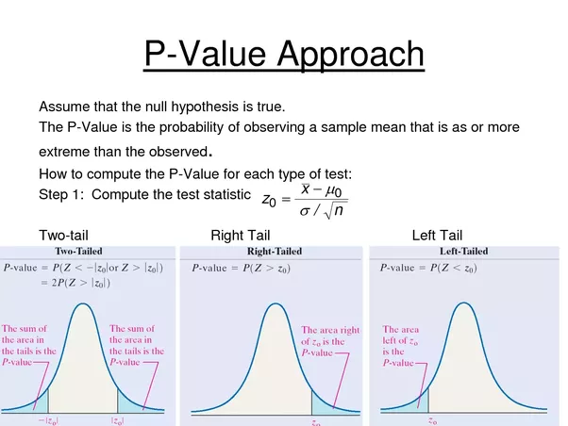
P-value

Slide 40
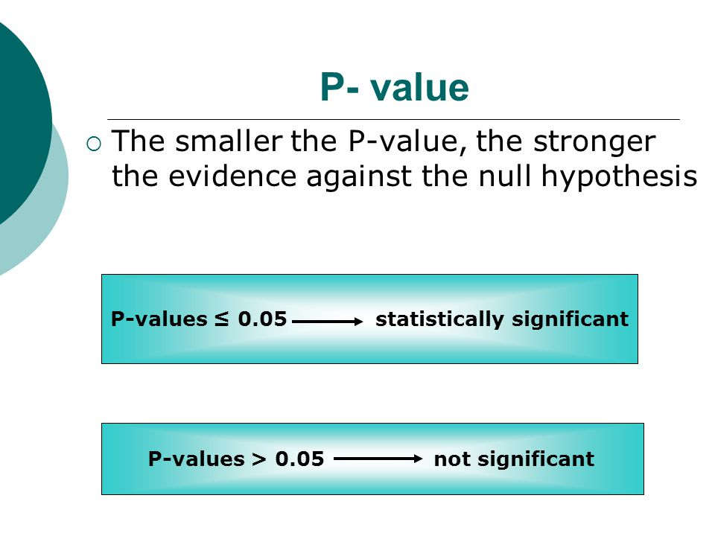
P-value
If p is high, null will fly.
If p is low, null will go.

Slide 41
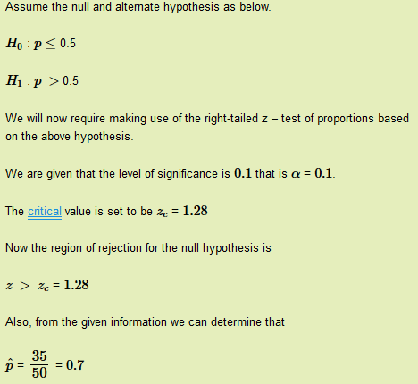
Right-tailed Hypothesis test example
Suppose a coin is tossed for times and we got 35 heads. With a significance level of 0.1. Determine if the coin is biased for heads.

Slide 42
Right-tailed Hypothesis test example

Slide 43
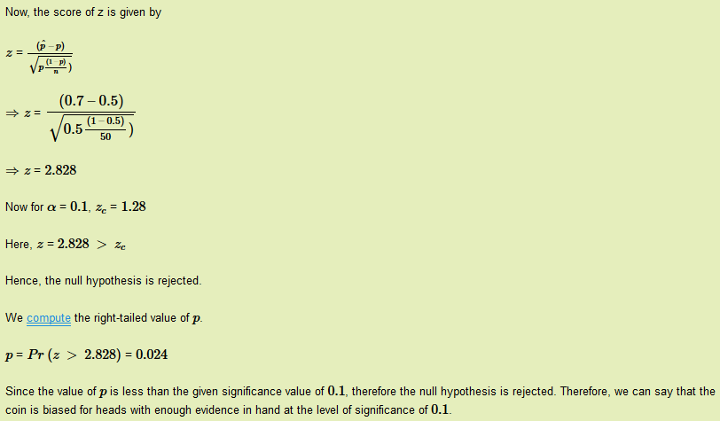
Right-tailed Hypothesis test example

Slide 44
Right-tailed Hypothesis test example

Slide 45
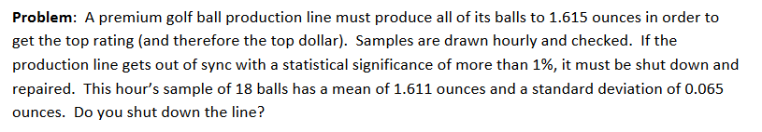
Two tailed Hypothesis test example:

Slide 46
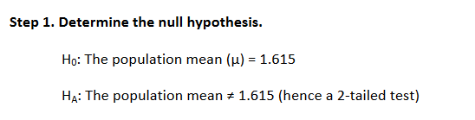
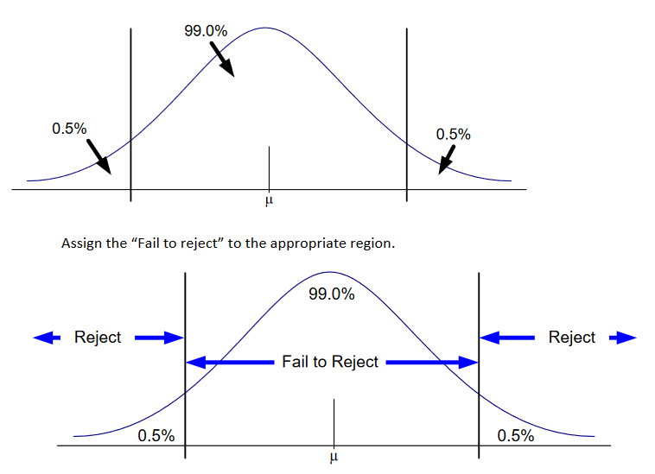
Determine the null hypothesis.
Step 2: Draw the t-test diagram

Slide 47
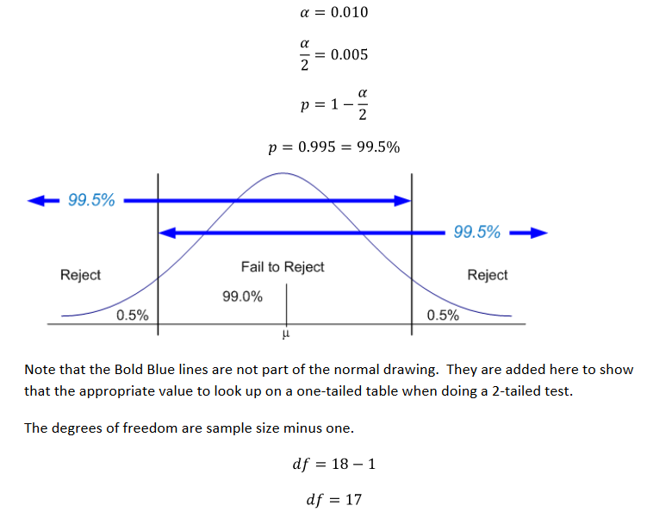
Step 3: Determine and label t_{p}
Two tailed Hypothesis test example:
Since our table is one-tailed and we are doing a two-tailed test, we have to divide the level of significance in half.

Slide 48

Using t-table:

Slide 49


Slide 50


Step 4: Calculate t_{calc} or t_{c}

Slide 51

Step 5: Determine the conclusions

Slide 52


Confidence Interval
A range of values so defined that there is a specified probability that the value of a parameter lies within it.

Slide 53

Left-tailed Hypothesis test example

Slide 54



Slide 55



Slide 56


